Slide 1

Challenge 1 Phishing Detection in Cybersecurity
Pitch

Slide 2



Tackling Phishing Threats
Evolving Phishing Threats
Phishing remains a significant risk for organisations, requiring constant advancement in security measures to keep data safe.
Intelligent Detection Systems
Expert systems can identify malicious URLs and phishing sites, surpassing the limitations of basic blacklists.
Scalable and Explainable Security
Flexible, explainable, and scalable systems offer robust, adaptive defence against ever-changing phishing techniques.
Notes:
O phishing continua a representar uma ameaça significativa para as empresas, tornando essencial o reforço das soluções de segurança. A nossa equipa está a desenvolver uma solução inteligente para detetar links maliciosos e sites de phishing, ultrapassando as limitações das listas negras tradicionais. Este sistema foi concebido para ser flexível, intuitivo e escalável, garantindo uma proteção sólida através de métodos inovadores e adaptáveis.

Slide 3

Key Project Objectives
Identifying Technical Indicators
We will model technical features that distinguish phishing attempts from legitimate online activities using expert analysis.
Developing Detection Systems
A detection system will be built, using rules-based and hybrid methods, utilising advanced tools and external threat intelligence.
Validation and Continuous Improvement
Our approaches will be validated with real-world scenarios, allowing for ongoing refinement as cyber threats evolve.
Notes:
Num primeiro momento, a equipa pretende identificar com rigor os sinais técnicos que distinguem atividades legítimas de tentativas de phishing. Em seguida, o foco está no desenvolvimento de uma solução avançada de deteção, combinando regras e abordagens híbridas com apoio de ferramentas como Drools e fontes de informação externas. Por fim, todos os métodos serão validados com casos reais, assegurando a evolução contínua do sistema perante novas ameaças.

Slide 4

Expert Knowledge Foundations
Academic Research Integration
We use leading academic research from trusted sources to inform and strengthen our approach.
Expert Practitioner Input
Direct insights from industry professionals ensure our methods are practical and up-to-date with real-world needs.
Agile and Practical Implementation
Hands-on experience guides agile rule development, effective risk communication, and identifying essential operational indicators.
Notes:
O nosso trabalho baseia-se em estudos académicos de referência e fontes de confiança como a IEEE, ACM, Scopus, ResearchGate, ENISA e o World Economic Forum Cybersecurity Outlook. Também recebemos conselhos valiosos do David Marques, Diretor de Cibersegurança do Grupo Nabeiro. A sua experiência prática ajuda-nos a criar regras flexíveis, comunicar riscos de forma clara e identificar os sinais de alerta mais importantes.

Slide 5
Knowledge Acquisition Process
Session-Based Knowledge Mapping
We conducted sessions to identify detection features and attack patterns used in the wild, leading to deeper understanding and clarity.
Validation of Security Insights
Key insights about redirect chains, domain reputation and false positives were validated and systematically collected for accuracy.
Rule Translation and Integration
Findings were converted into Drools rules, integrated with security APIs and refined through feedback cycles.
Notes:
Fizemos várias reuniões para identificar os problemas e preparar perguntas para o especialista. As ideias recolhidas sobre cadeias de redirecionamento, reputação de domínio e falsos positivos foram verificadas e organizadas. Depois, estas ideias foram transformadas em regras e melhoradas com feedback em várias etapas.

Slide 6

Two-Phase Risk Detection Engine
URL Analysis
The first phase uses static analysis to evaluate URL age, structure, tokens, redirections, and known risky patterns for initial risk detection.
Dynamic Content Inspection
The second phase inspects rendered HTML, JavaScript, forms, link ratios, and detects impersonation to assess deeper risks dynamically.
Weighted Risk Scoring
Both phases assign weighted scores, creating a transparent, auditable assessment that guides final safety decisions.
Notes:
A nossa implementação avalia URLs em duas fases. Numa primeira fase são verificados aspetos como idade do dominio, estrutura lexical, tokens, redirecionamentos e padrões conhecidos. Numa segunda fase, em casos inconclusivos, uma análise dinâmica que examina o HTML gerado, JavaScript, campos de formulários, proporção de links é efetuada. Cada fase produz uma pontuação de risco ponderada para uma decisão final transparente e auditável.

Slide 7
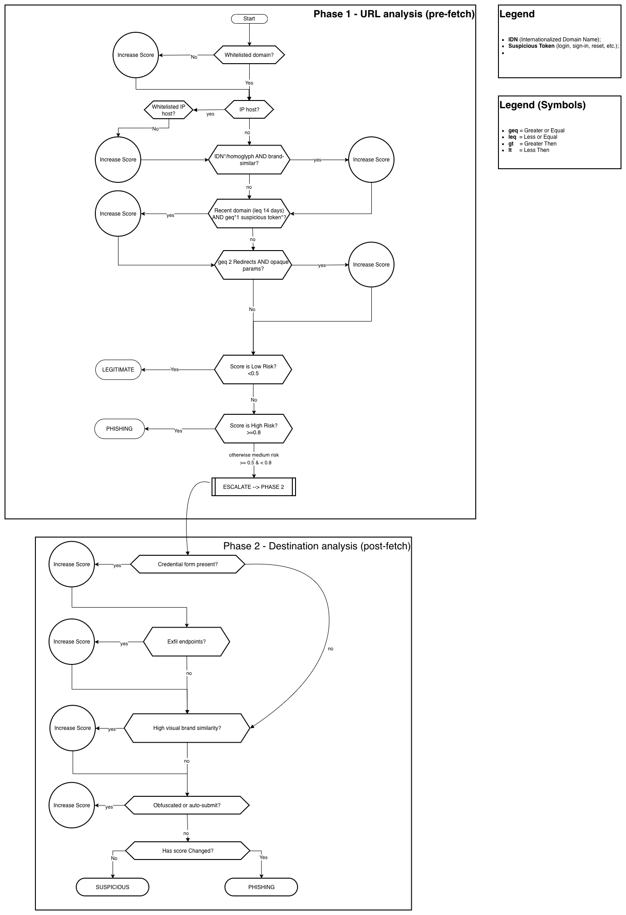

Slide 8

First: The Suspicious Shortcut Adventure
A user clicks: http://bit.ly/3xZpF8a
Our engine springs into action. First stop, R1.C - URL Shortener Detection—this is a classic shortcut: bit.ly! It’s flagged instantly.
The engine follows the redirect path:
R1.A - Redirect Depth Analysis: One, then two quick jumps: redirect1.com, then finally landing at hack-paypal.com/login. Multiple redirects—something attackers love.
R1.B - Domain Diversity: The domains are all different. That’s the attacker’s trick—hop across unrelated servers to stay hidden.
As soon as our engine sees hack-paypal.com, it does a quick check:
R1.E - Blacklist Check: Red alert. hack-paypal.com is on our blacklist of known phishers.
All these alarms ring together. Our system scores each rule and combines them, concluding with a bold red warning: “Phishing Detected - High Confidence”

Slide 9
Second: The Trusted Internal Chain
Another link comes through: https://secure.intranet.corp.com/app
It quickly hops, just once, to internal-redirect.corp.com/home.
Our engine runs the same rules:
R1.A - Redirect Depth Analysis: Only one redirect, the most common for internal navigation.
R1.B - Domain Diversity: Two domains, but both have the same corporate root—safe so far.
R1.C - URL Shortener Detection: Not detected.
R1.E - Whitelist Check: Both domains well known, trusted and validated by our system.
The engine weighs every signal. This time, the outcome is calm and reassuring: “Legitimate - No risk detected”

Slide 10

Key Findings and Insights
Multi-source Evidence Approach
Aggregating redirection depth, domain diversity, shortener detection, reputation, and behavioural cues improves detection of security threats.
Adaptable Security Strategies
Security strategies should be adaptable, reviewed regularly, and based on real incident analysis rather than static rules.
Focus on Explainability and Experience
Prioritising explainability and user experience is more effective than relying only on strict blocking mechanisms.
Notes:
Domínios legítimos podem ativar regras de segurança sem querer, por isso o nosso sistema reúne várias fontes de prova: profundidade de redirecionamento, diversidade de domínios, deteção de encurtadores de links, reputação e sinais de comportamento. Os especialistas recomendam adaptar as estratégias, rever incidentes reais com frequência e dar prioridade à clareza das decisões e à experiência dos utilizadores, em vez de depender só de bloqueios rígidos.

Slide 11
Meet Team 10
ARSÉNIO FERRAZ – 1010137
BRUNO CAMARNEIRO – 1250422
CÉSAR VIEIRA – 1241523
GUSTAVO LIMA – 1221349
RUI SOARES - 1221283

